Slide 1
VEHICLE MANAGEMENT SYSTEM USING SALESFORCE
Team leader: K.Thamirabharani
Team member 1: S.Karthika
Team member 2: M.Nivetha
Team member 3: C.Gayathri
Team member 4: N.Nagalakshmi

Slide 2
INTRODUCTION
OVER VIEW:
The Vehicle Management system (VMS) is an application for the Automotive industry. It supports, in the area of Sales & Services, the business processes that you require as vehicle importer when dealing with your original equipment manufacturers (OEMs)and your dealers in new and used vehicle sales.

Slide 3
PURPOSE
The use of this project.
The main use of this project is save our time.
To reduce paper misplacement.

Slide 4
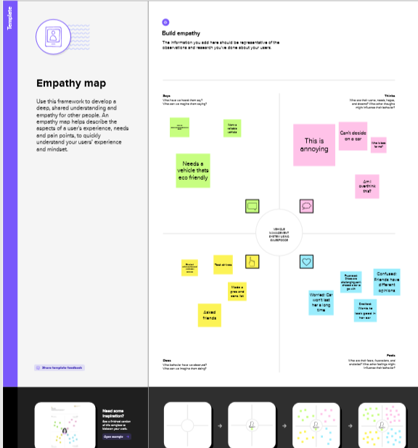
PROBLEM DEFINITION AND DESIGN THINKING
EMPATHY MAP

Slide 5
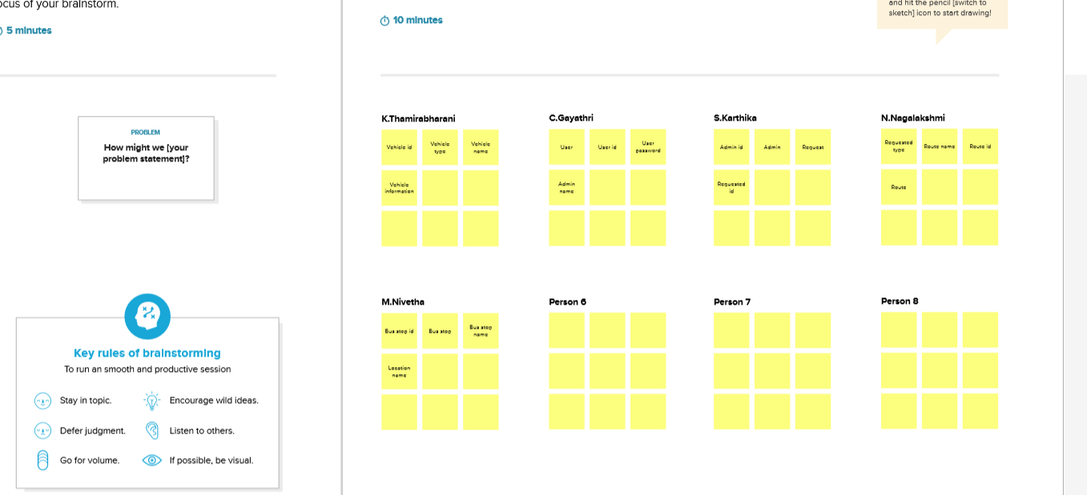
BRAINSTORMING

Slide 6
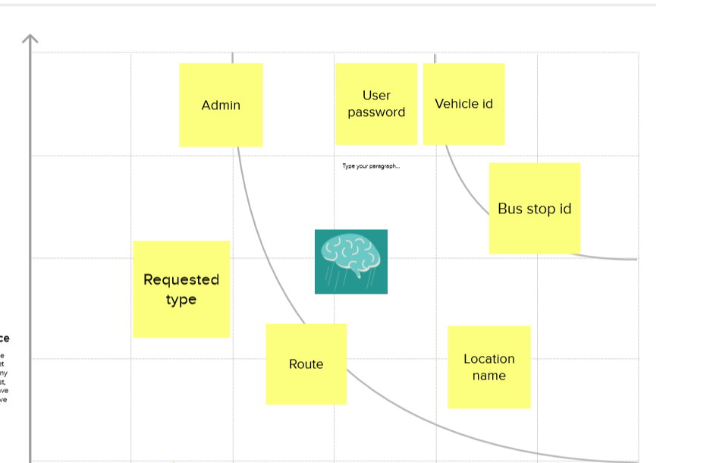
MAP

Slide 7
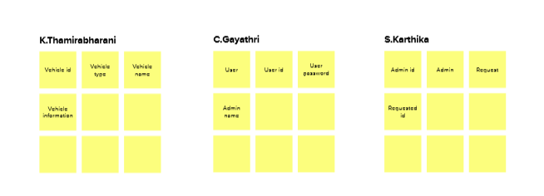
BRAINSTORMING

Slide 8
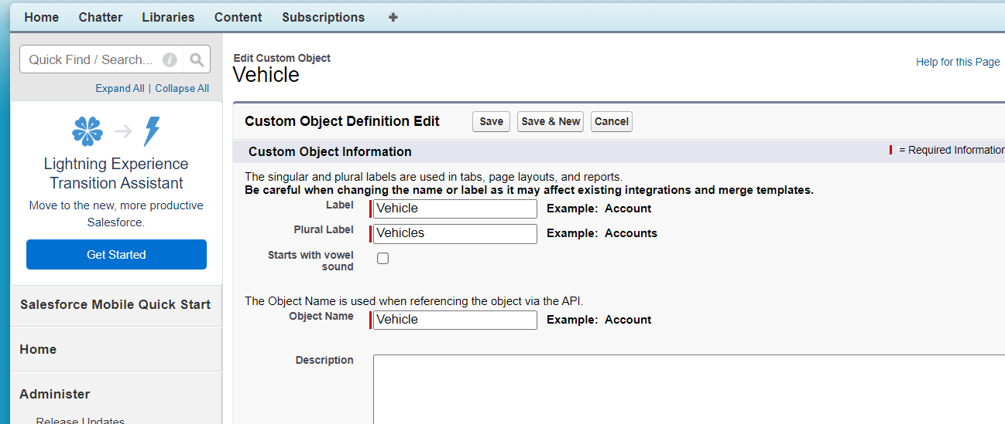
OBJECT
Vehicle
To tracking internal we need the custom objects.

Slide 9
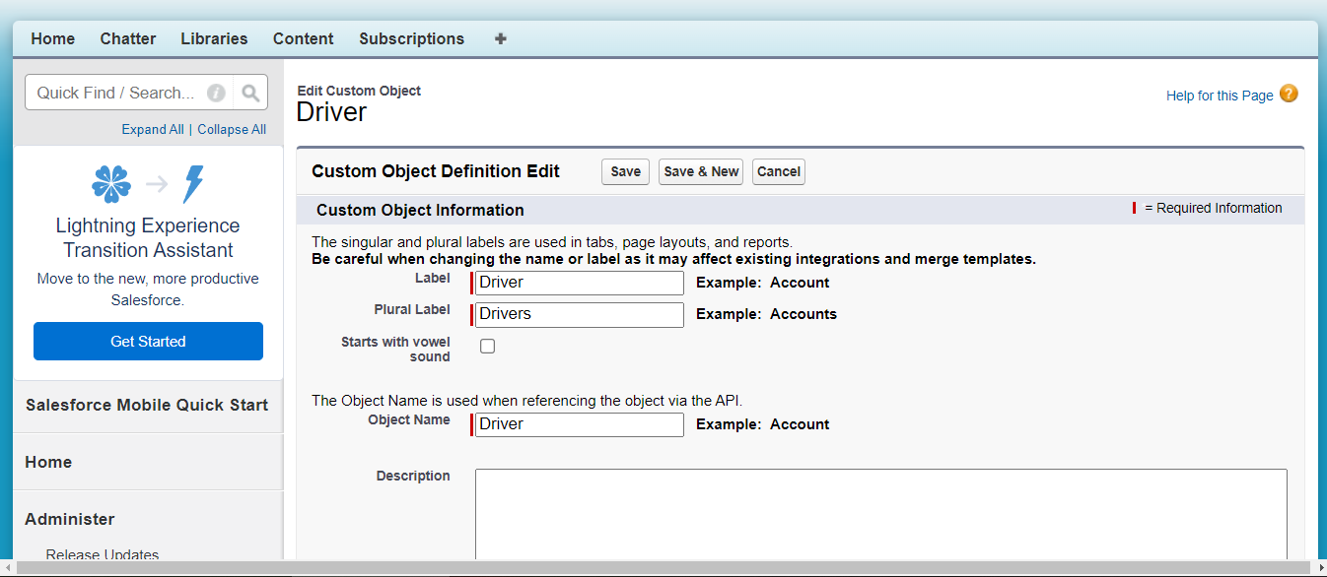
OBJECT
Driver

Slide 10
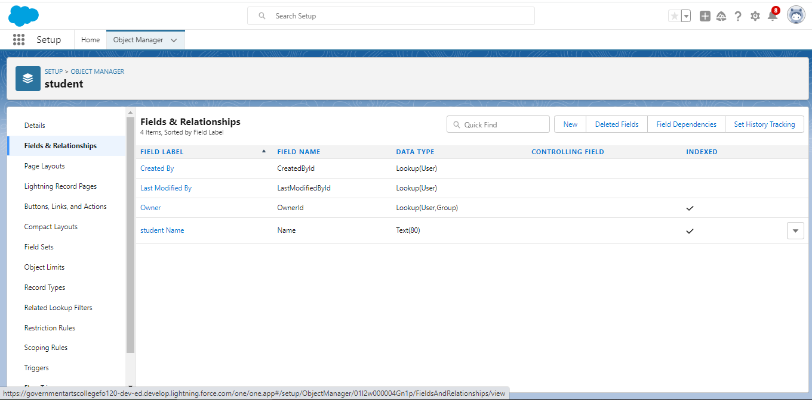
FIELDS AND RELATIONSHIPS
An object relationship in Salesforce is a two-way association between two objects.

Slide 11
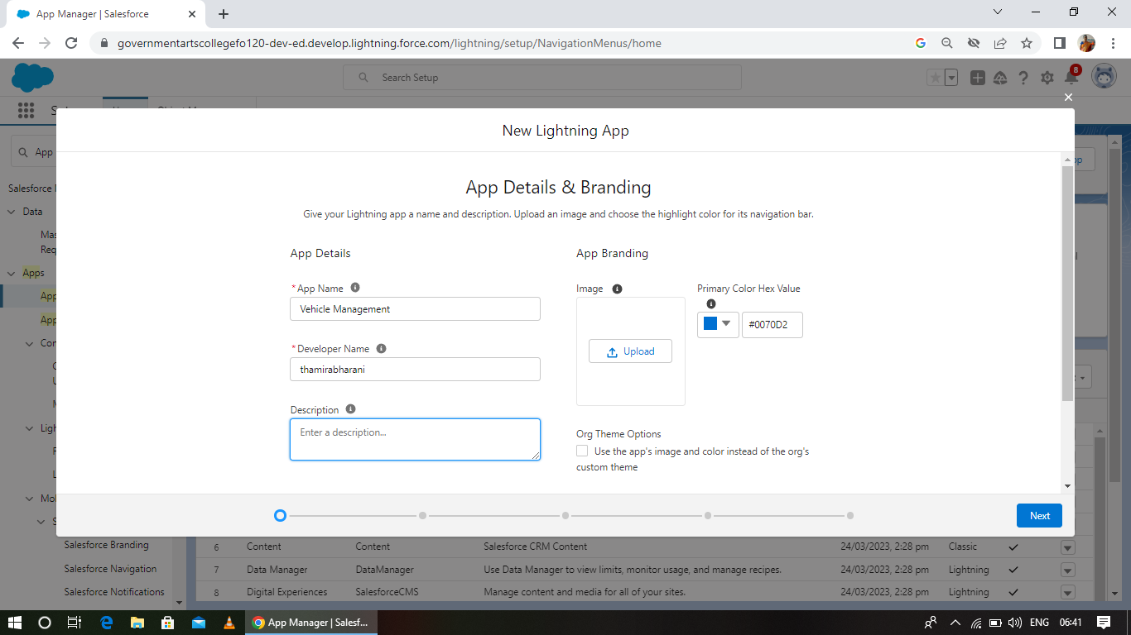
LIGHTNING APP
It has a name logo.

Slide 12
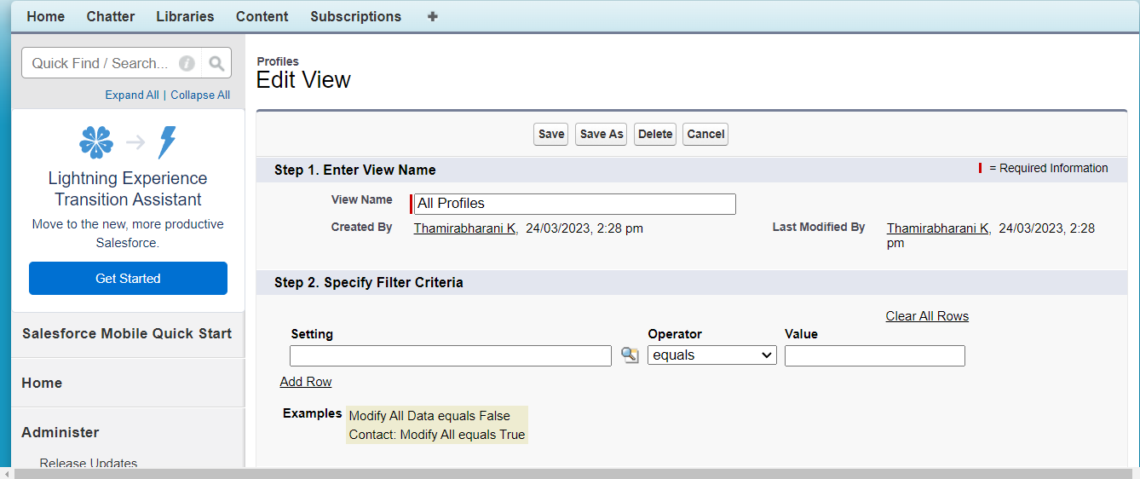
PROFILE
A Profile is a group/collection of setting and permission that define a user can do in salesforce.

Slide 13
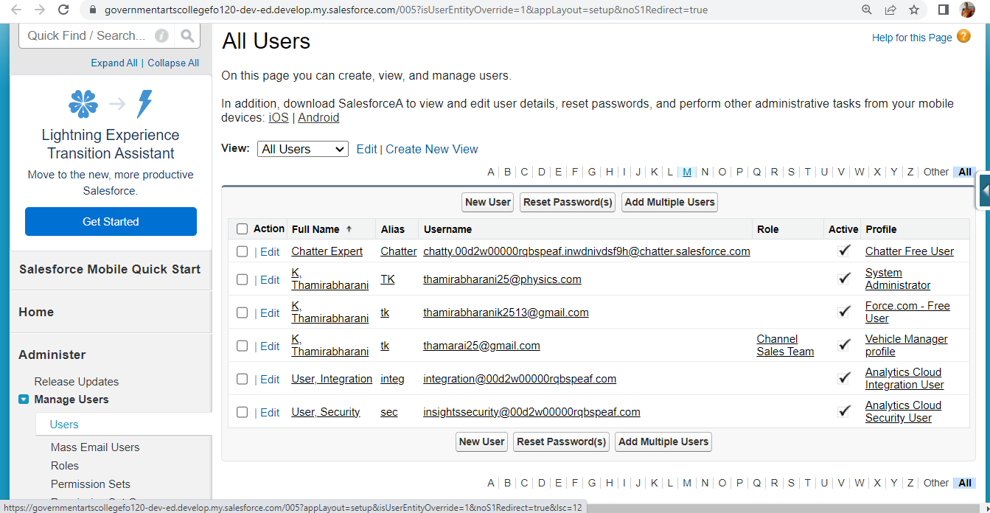
USERS
Every user in Salesforce has a user account

Slide 14
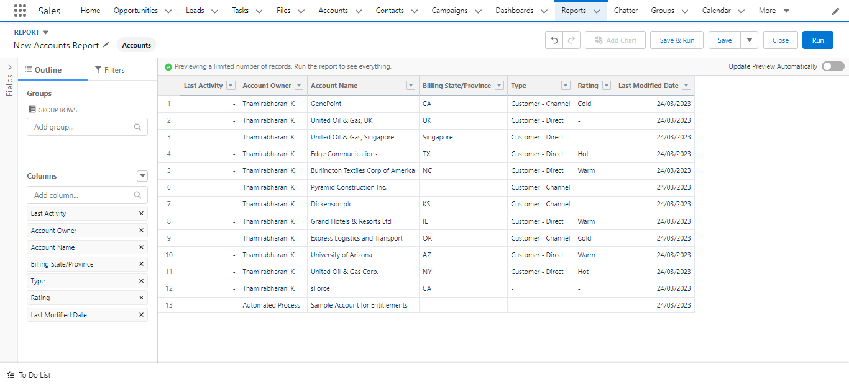
REPORTS
Reports are used to customise our project.

Slide 15
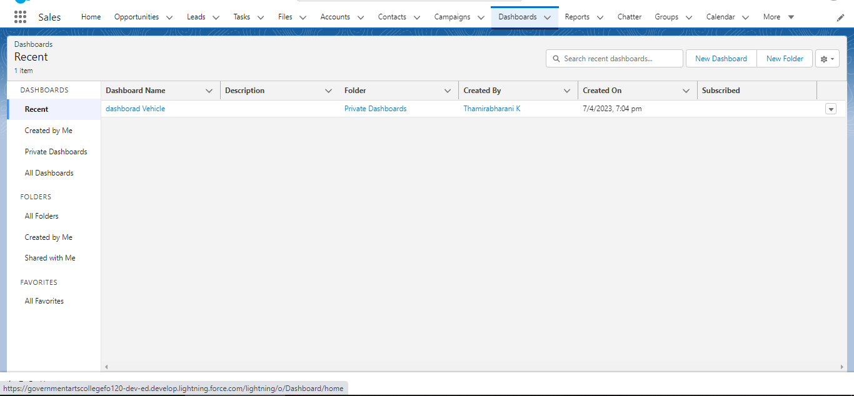
DASHBOARDS
Dashboard are used to apply many data in a signup dashboard.

Slide 16
RESULT
OBJECT NAME | FIELD IN THE OBJECT
1.Vehicle | Field Name | Data Type
 | Customer Name | Text
 | Customer Mobile No | Number
 | Vehicle Name | Text
 | Start Date | Date/time
2.Driver | Driver Name | Text
 | Mobile No | Number
 | Vehicle | Lookup
 | Licence No | Text

Slide 17
TRAILHEAD PROFILE
Team leader: https://trailblazer.me/id/thamk10
Team members:
1. https://trailblazer.me/id/samayakaruppan
2. https://trailblazer.me/id/nivem27
3. https://trailblazer.me/id/gayac7
4. https://trailblazer.me/id/nnatchimuthu

Slide 18
ADVANTAGES
It helps to reduce cost of fuel.
It ensures safety of vehicles, drivers and goods.
It helps in saving of maintenance costs by maintaining fleet effectively.

Slide 19
DISADVANTAGES
It requires skilled resources to maintain such system. This increases maintenance costs.
GPS device used in fleet management is power hungry which drains battery faster.

Slide 20
APPLICATION
The Vehicle management system (VMS) is an application for the automotive industry .
It supports , in the area of sales & services , the business processes that you require as vehicle importer when dealing with you original equipment manufacturers (OEMs) and your dealers in new and used vehicle sales.

Slide 21
CONCLUSION
A Vehicle management system is a software system or platform that serves to manage commercial fleets of vehicles, such as cars, vans or trucks or even heavy equipment to ensure they’re utilized safely, efficiently and professionally, while making sure they’re well maintained and high-performing

Slide 22
FUTURE SCOP
Project Manager..
System Developer..

